Slide 1
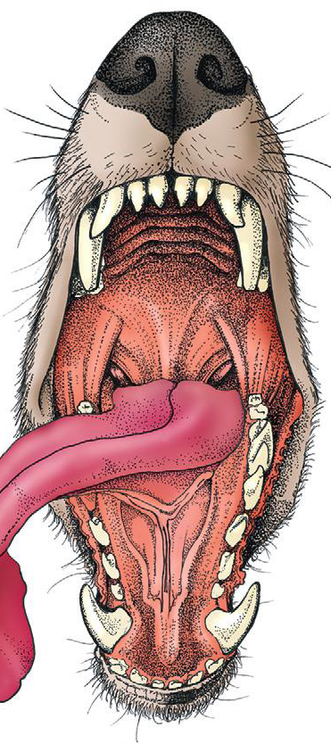
Oropharynx surgery
Assis. Prof. Dr. Rafid Majeed Naeem

Slide 2
The oral cavity proper refers to the space between the lower and upper dental arcades.
Oropharynx: The space ventral to the soft palate bound caudally by the pharyngeal wall.
The oropharynx is the space between the oral cavity proper and the laryngopharynx and nasopharynx.
It is bound dorsally by the soft palate and ventrally by the root of the tongue.

Slide 3
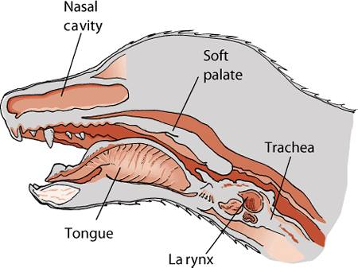
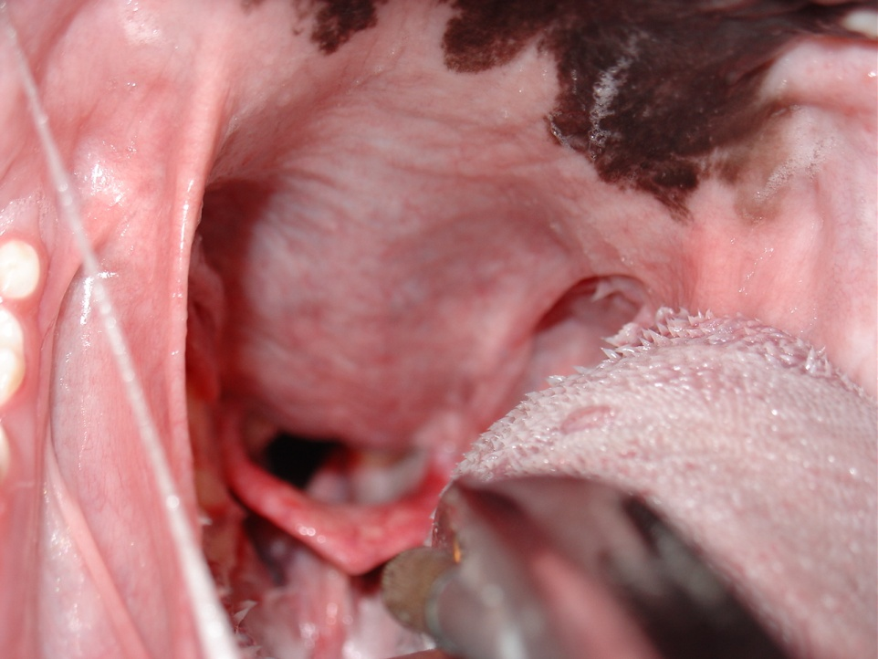
The soft palate helps protect the nasopharynx from entrance of food during deglutition by becoming taut and elevated by tensor and levatorvelipalatini muscles.
This action results in the caudal free edge of the soft palate pressing on the pharyngeal wall, sealing off the nasopharynx.

Slide 4
Swallowing, also called deglutition, is the transport of food or water from the mouth to the stomach and is one of the most complicated actions controlled by the central nervous system.
It requires the coordinated actionsحركات منسقة of muscles in the mouth, pharynx, larynx, and esophagus,. Alterations in this process can cause dysphagia عسر البلع, aspiration, or regurgitation.
The entire process of deglutition has been divided into three phases:
oropharyngeal,
esophageal, and
gastroesophageal.

Slide 5
The oropharyngeal phase has been further subdivided into the oral, pharyngeal, and pharyngoesophageal stages.
The oral stage involves formation of a food bolus by compression of food between the tongue and palate. The bolus is then propelled toward the base of the tongue at the entrance of the pharynx.
This stage is completely voluntary.
2. The bolus at the base of the tongue stimulates the reflex pharyngeal stage of deglutition. The tongue and pharyngeal constrictor muscles transport the food bolus through the pharynx through a peristaltic-like manner.
To prevent food from entering the airway, the epiglottis covers the glottis, and the soft palate presses against the pharyngeal wall to block the entrance to the nasopharynx.

Slide 6
The pharyngeal stage is involuntary
3. The passage of food from the pharynx through the cricopharyngeal sphincter and into the esophagus is the pharyngoesophageal stage of deglutition.
Relaxation of the sphincter starts as soon as the pharyngeal muscles begin constriction. The degree of sphincter opening varies with the size and consistency of the bolus.
The pharyngoesophageal stage terminates with closure of the sphincter and relaxation of the pharyngeal constrictor muscles. This stage is also involuntary

Slide 7
General clinical signs of oral disease include
ptyalism (an abnormal and excessive secretion of saliva),
dysphagia (a difficulty in swallowing),
inappetence (reduction or complete loss of appetite),
weight loss,
pain,
halitosis (Bad mouth smell)
oral hemorrhage.

Slide 8
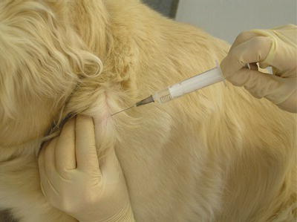
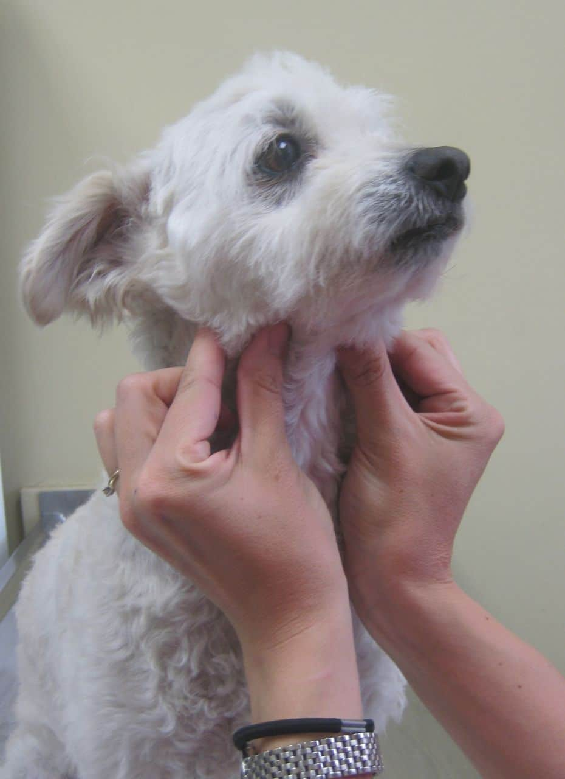
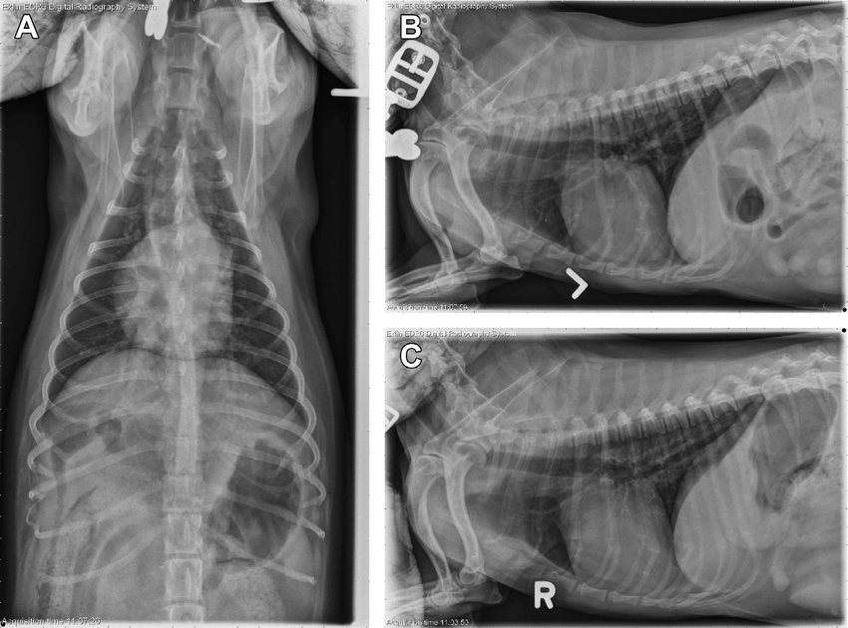
In patients known or suspected to have oral neoplasia, cytologic evaluation of fine needle aspirates taken from mandibular lymph nodes is recommended.
Medial retropharyngeal lymph nodes are palpable only when they are significantly enlarged.
Evaluation of a three-projection thoracic radiograph study is a good for detection of metastasis in the lungs and other thoracic structures or if lower airway tract disease is suspected.

Slide 9
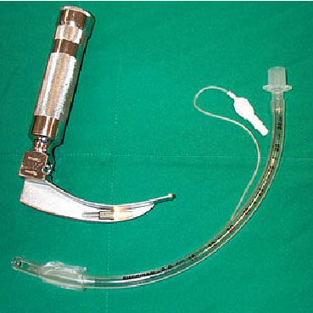
Preoperative Preparation
Tumors or swelling in the oral or pharyngeal cavity can complicate intubation.
A laryngoscope with adequate lighting, endotracheal tubes of multiple sizes, and availability of an oxygen mask are essential.
When anesthetizing patients with large masses or for those that have already displayed signs of dyspnea, instruments for performing an emergency tracheotomy should be available.

Slide 10
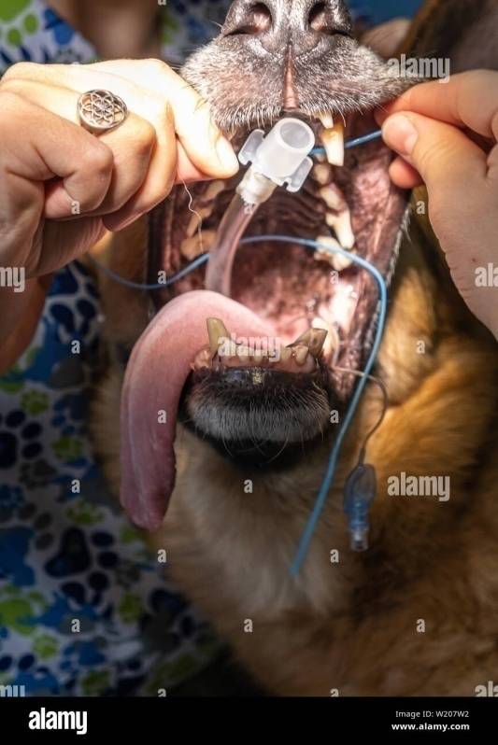
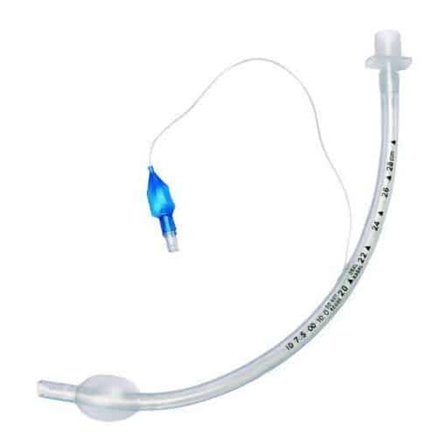
After the endotracheal tube is in place, it should be secured so as to not interfere with the surgical site
An appropriately sized endotracheal tube (with a properly inflated cuff), along with absorbent material packed in the back of the pharynx, will usually prevent significant leakage into the trachea.

Slide 11
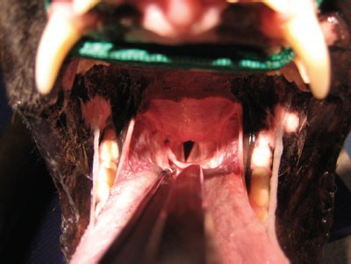
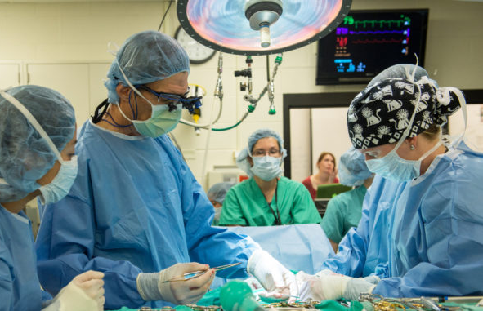
Visualizing the pharynx and evacuating any fluid with a suction tube immediately before extubation may also help prevent fluid aspiration and will ensure that packing material is not left in the pharynx.
.(Yankauer suction tip)
Povidone– iodine solution or a 0.2% chlorhexidine solution is used for preparation of the oral mucosa.
Perioperative antibiotics are generally not indicated because the mouth is remarkably resistant to infection, presumably because of its excellent blood supply and the antibacterial properties of saliva.

Slide 12
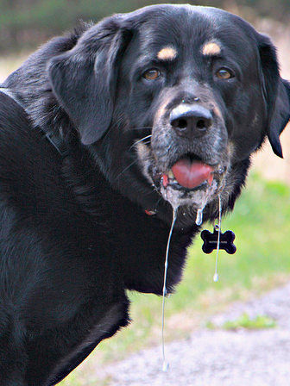
DISORDERS OF THE OROPHARYNX
Dysphagia
Dysphagia: is difficulty swallowing during any stage of deglutition
Symptoms of dysphagia affecting the oral stage of deglutition may include difficulty prehending food or lapping water; retention of food or water in the mouth; and failure to swallow saliva, resulting in drooling.
Some animals are able to compensate by making sudden head movements while eating in an attempt to move food back into the pharynx.
If other stages of deglutition are normal, animals with oral stage dysphagia may benefit from feeding and providing water in an elevated position to aid delivery of food and water to entrance to the pharynx.

Slide 13
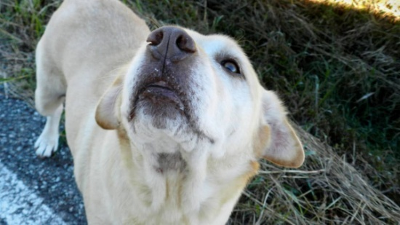
Clinical features of dysphagia during the pharyngeal or pharyngoesophageal stages usually include repeated unsuccessful attempts at swallowing.
Food may be regurgitated back into the oral cavity or may stay in the pharynx.
Because the epiglottis relaxes at the termination of swallowing and leaves the airway unprotected, affected animals are at risk for laryngotracheal aspiration.
In animals with dysphagia of the pharyngeal or pharyngoesophageal stage, function is not improved by feeding in an elevated position or placing food at the base of the tongue.

Slide 14
Etiology and Diagnosis
Dysphagia usually results from space-occupying masses, structural congenital abnormalities, or functional abnormalities.
Structural Abnormalities and Masses. Structural congenital abnormalities resulting in dysphagia include congenital palate defects, ankyloglossia (limited normal movement of the tongue chiefly due to an abnormally shortened frenulum : tongue-tie), macro- and microglossia. These should be easily detected on oral examination under sedation or anesthesia.
Space-occupying masses resulting in dysphagia include extrapharyngeal masses, such as enlarged retropharyngeal node(s), cervical abscess or granuloma (a focal aggregate of immune cells), and invasive salivary or thyroid neoplasms, and masses of the palatine tonsils.

Slide 15
Treatment depends on the specific cause. A mass in the oral cavity may not cause any symptoms until it reaches a critical size, subsequently resulting in drooling, difficulty in food prehension, or malodor.
Masses located in the pharynx usually result in difficulty swallowing or dyspnea and require sedation or anesthesia to visualize except in the most cooperative patients.
Pharyngeal masses that result in an acute onset of dyspnea require rapid decompression (e.g., incisional drainage of mucoceles) or intubation to quickly unobstruct the airway.
Dysphagia from penetrating injuries may occur from the presence of a foreign body , swelling, pain, or infection associated with the trauma.

Slide 16
Fluoroscopic evaluation of the swallowing process using barium contrast is the most useful tool in diagnosing and further characterizing functional dysphagia.
Patients with pharyngeal dysphagia will make repeated attempts to swallow, but the food bolus fails to move past the pharyngeal constrictor muscles and remains in the pharynx.
In contrast, patients with pharyngoesophageal dysphagia will have normal movement of the bolus through the pharynx, but the bolus will fail to pass through the cricopharyngeal sphincter, either remaining within the pharynx or redirecting into the larynx.
The most common pharyngoesophageal dysphagias are cricopharyngeal asynchrony and cricopharyngeal achalasia.

Slide 17
Penetrating Injuries to the Oropharynx
Penetrating trauma to the mouth from foreign objects is sometimes seen in dogs that carry or chew sticks and is seen rarely in cats.
The most common presenting complaints are dysphagia, drooling, depression, oral pain, pain on flexion of the neck, subcutaneous emphysema in the cervical region, blood in the saliva, and pain on opening of the mouth.
Cervical, cranial, or facial swelling is a common presenting complaint in chronic cases.
Additionally, chronic cases may have a draining sinus tract in the cervical region.

Slide 18
Diagnostics
Plain radiographs of the cervical region, including the retropharyngeal space, are recommended for initial diagnostic workup in animals with a suspected or confirmed penetrating injury to the oropharynx or esophagus.

Slide 19
Common sites of penetration are the esophagus, lateral and dorsal pharyngeal walls, and sublingual region.
The decision to use advanced imaging is based on the chronicity of the injury, the presence of cervical swelling, and radiographic signs of gas or tissue reaction within the cervical region.

Slide 20
Surgery
Wound exploration, debridement, and lavage may be adequate treatment in most cases of penetrating trauma.
Surgical exploration of the retropharyngeal space is accomplished through a ventral midline approach.
Care is taken to avoid disruption of the recurrent laryngeal nerves during dissection.
The goal is to locate and remove foreign material, obtain tissue or fluid samples for cytology and culture, debride nonviable tissue, and establish drainage if necessary.

Slide 21
administration of antibiotics is usually indicated if infection is suspected.
Therapy can be modified after culture and sensitivity results are available.

